Slide 1

Doing Background Research
By BAYOU bUILDERS & NeXt Gen

Slide 2
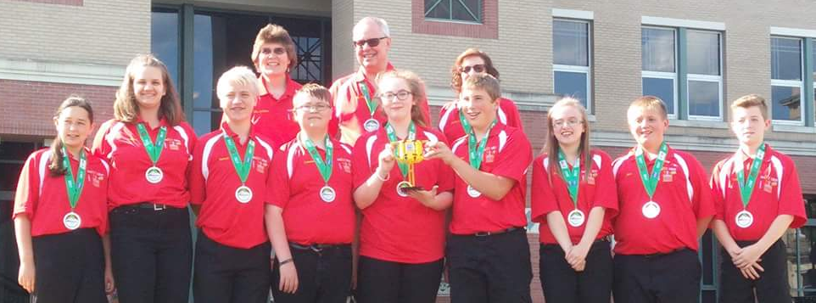
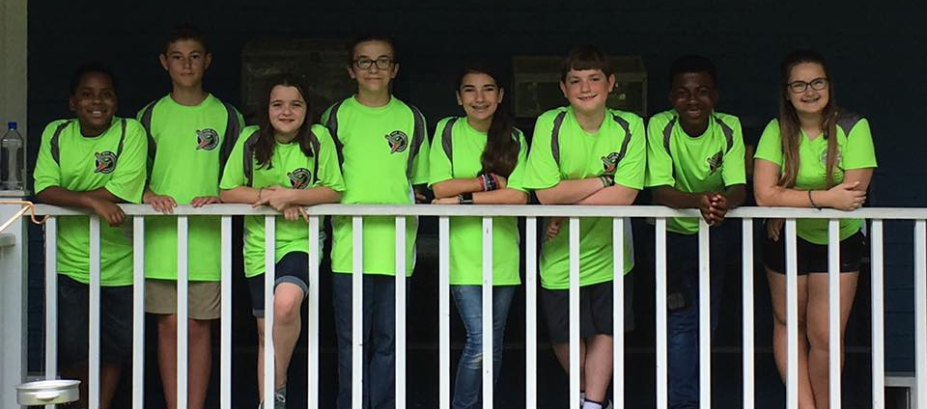
About Us
NeXT Gen are a middle school team from Garrett County, Maryland with 13 years in FIRST LEGO League (including competing in International Tournaments).
They have won first place in 2013 Global Innovation Award. They also won Top 20 GIA Semi-Finalist in 2017 for innovative solution, BeeHaven.
In addition, they won first Place Innovative Solution at Mountain State Invitational in 2017.
Bayou Builders are a 10-person, community-based team in Hammond, Louisiana.
They have won the Champions’ award every year and attended the North American Open as well as World Festival. In 2017, they were also nominated for the Global Innovation Award from Louisiana.

Slide 3
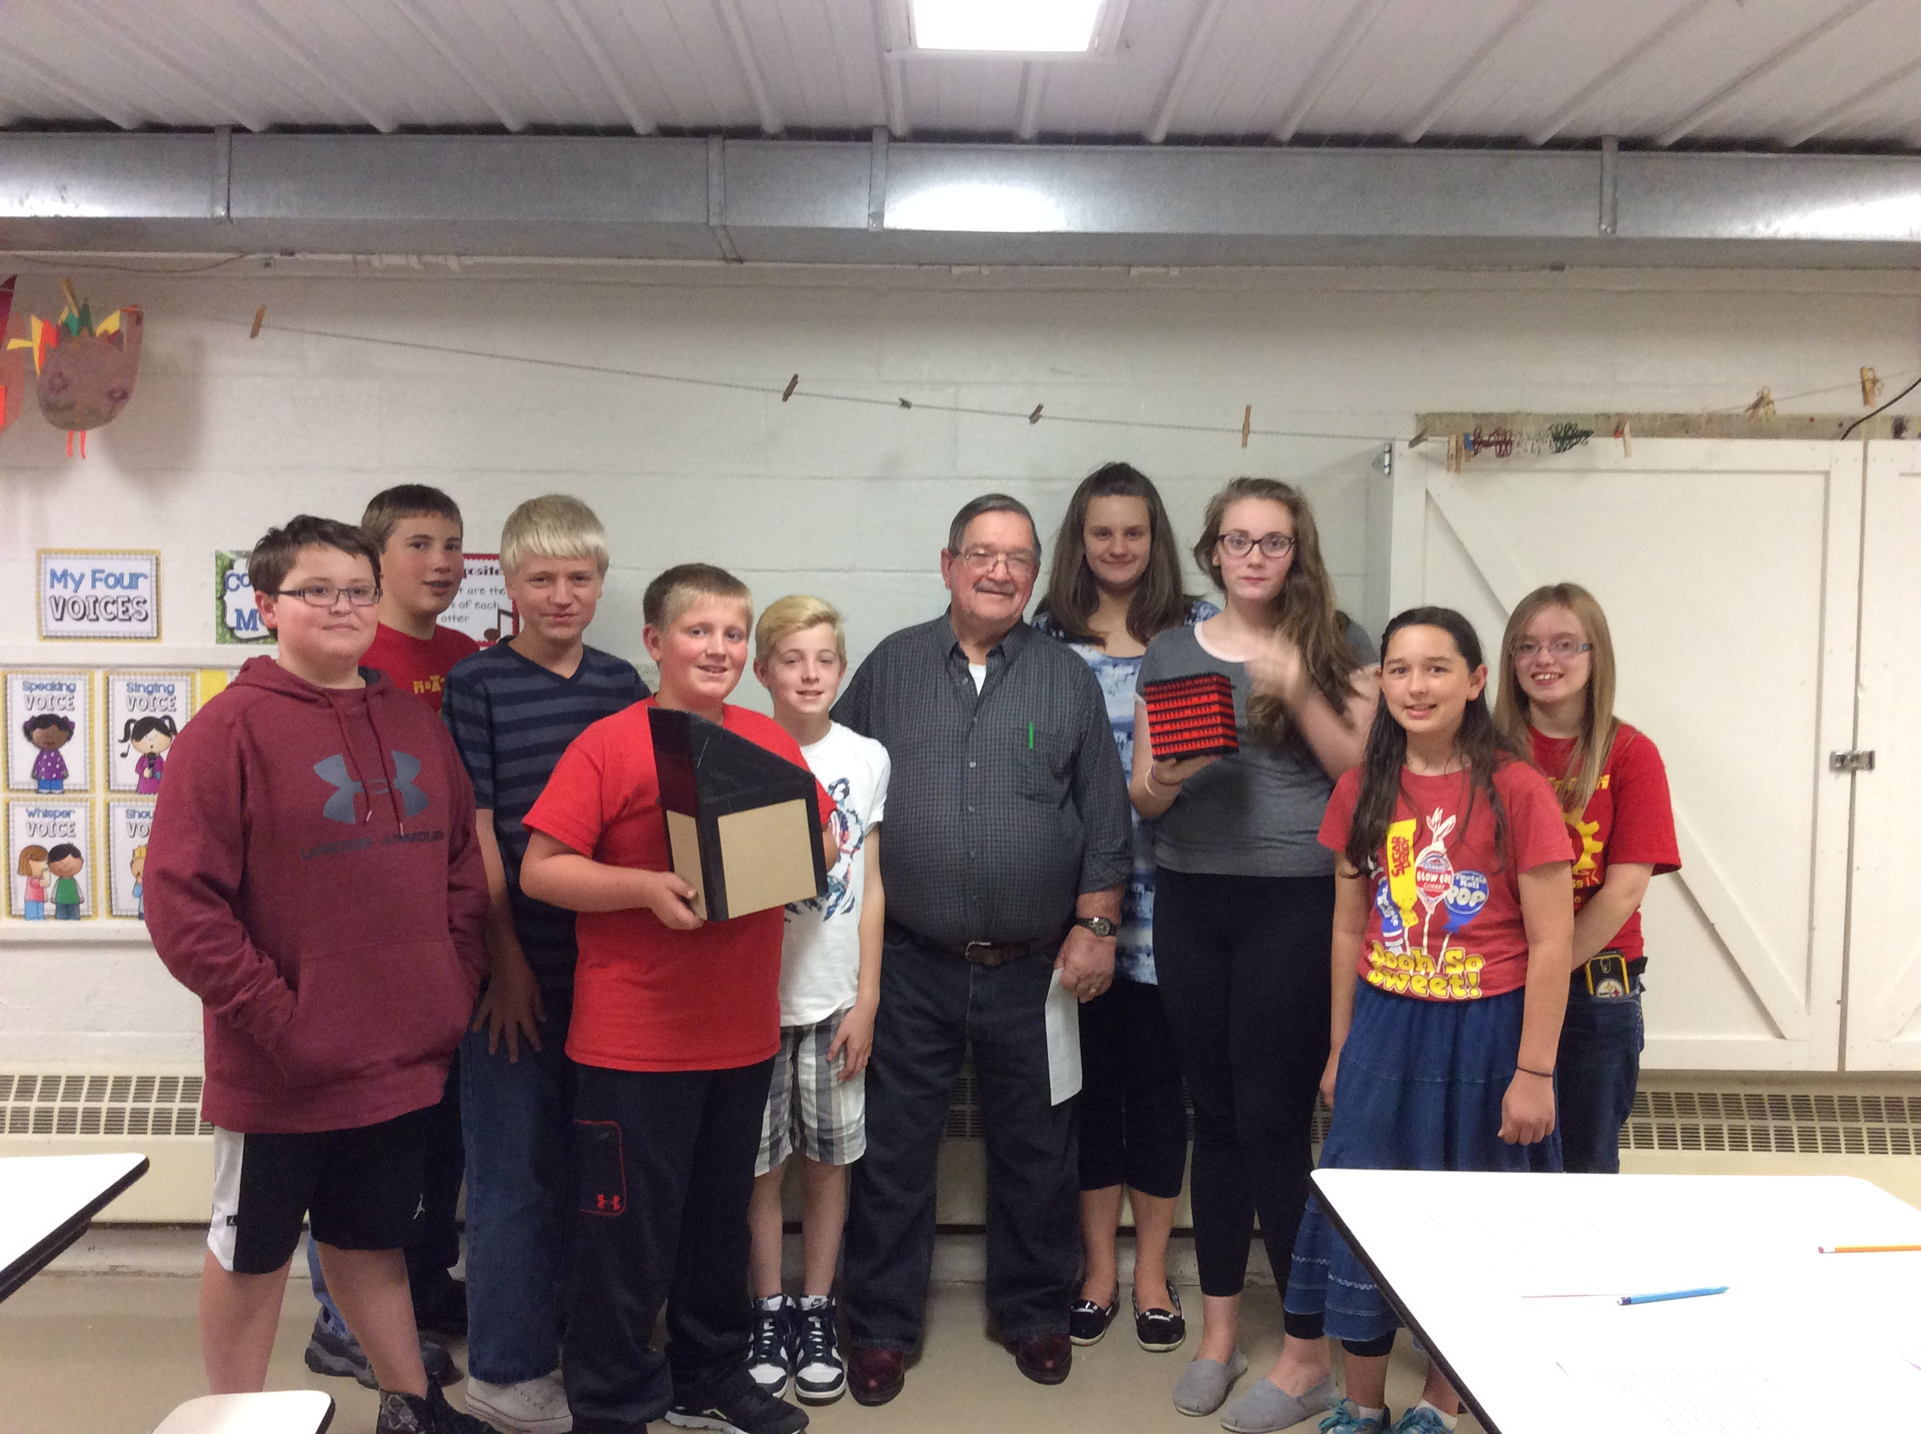
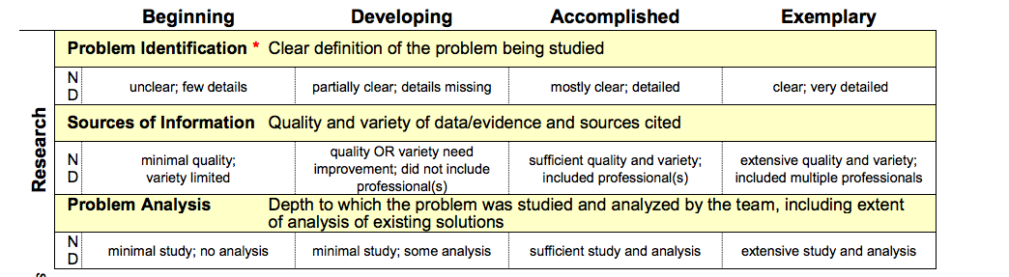
Types of Sources
Use a variety of sources including websites books, magazines, reports, professionals
Go on fieldtrips
Collect your own survey data
Remember that all sources need to be cited
Shared by: NeXT GEN

Slide 4
Creating the Bibliography
Creating a team bibliography is helpful
Allows a team to easily find the resources again if additional information is needed.
Bibliographies can also be handed to the judges to show research.
Tips:
Google Drive: Share your resources with your team using Google Sheets
Annotated Bibliography: An annotated bibliography that describes briefly what each website or other source taught us is very helpful in remember the sources
Shared by: NeXT GEN

Slide 5
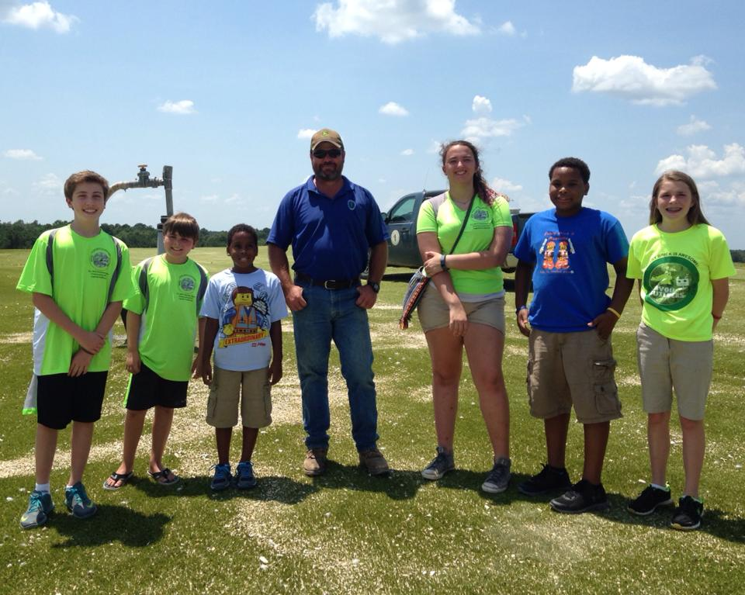
Going on Fieldtrips
Sometimes fieldtrips to local companies and organizations are possible. You can even go on fieldtrips before the start of the season
For example, during the Trash Trek season, we toured our local landfill
Animatronics went to a Nature Reserve to learn about Chimney Swifts
Shared by: Bayou Builders

Slide 6
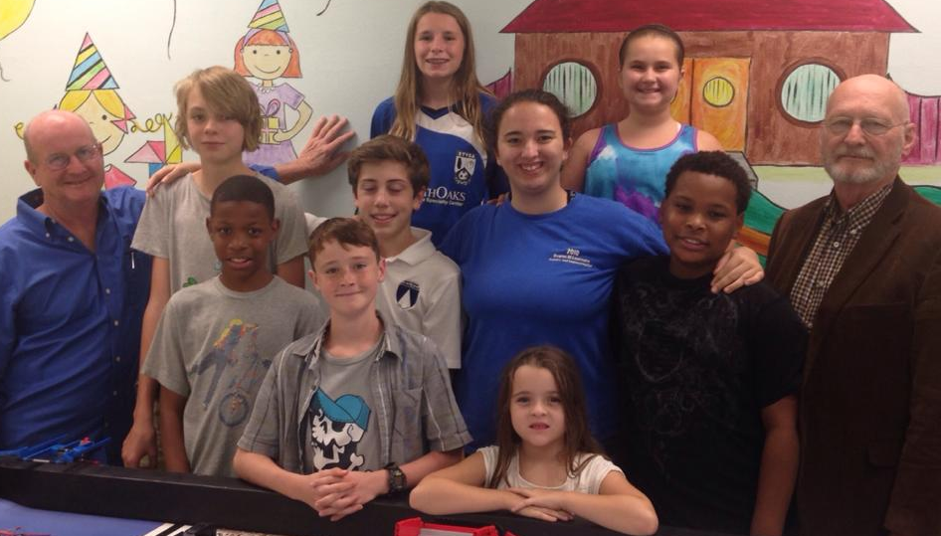
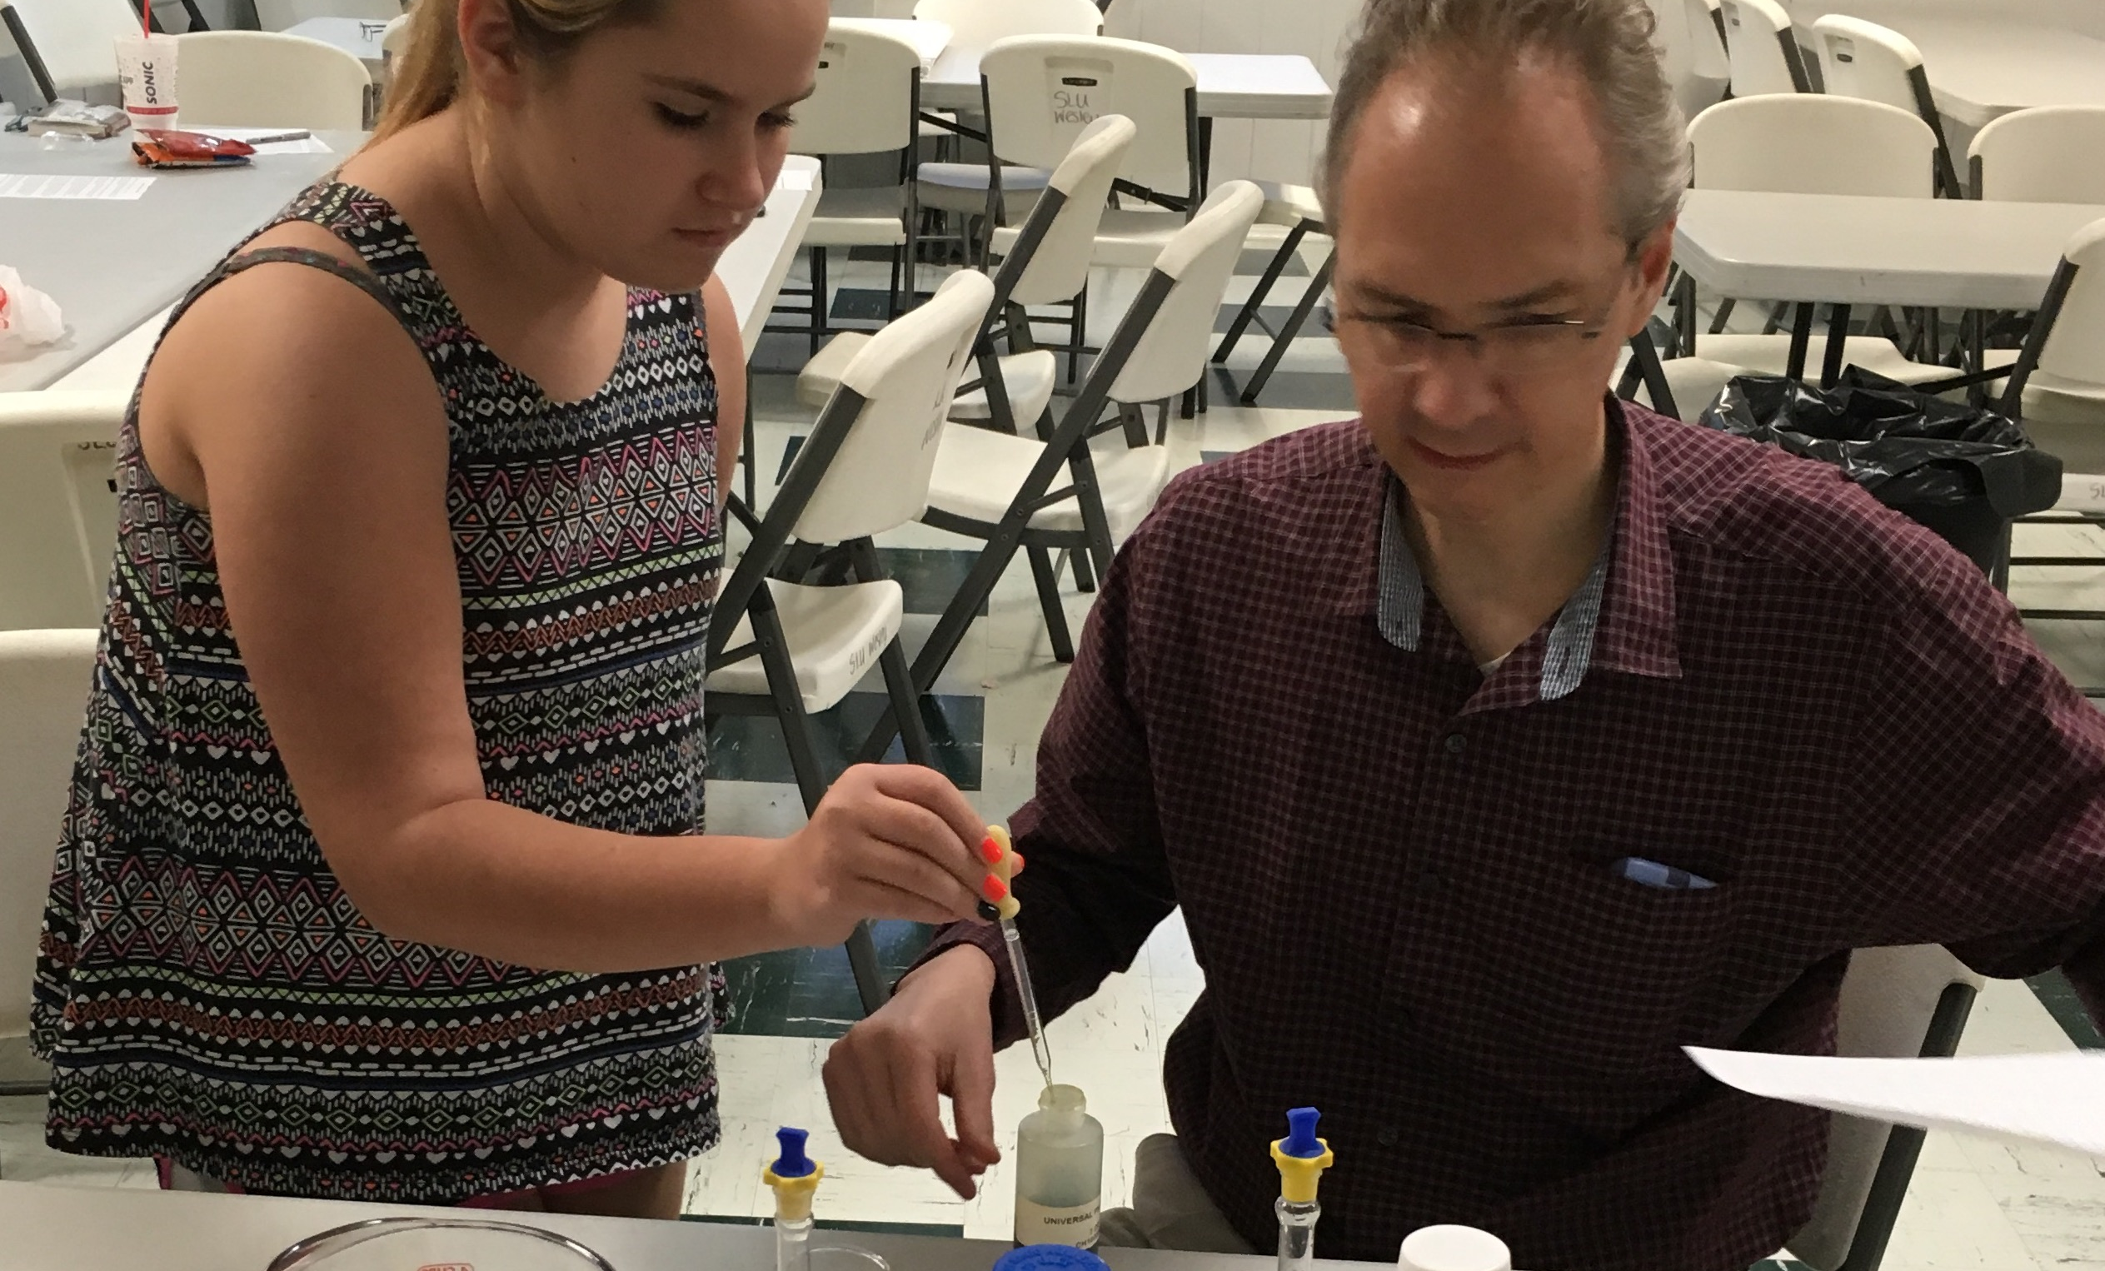
Talking to Experts
Find an expert you can learn more from
During the World Class season, we met with an education professor to learn more on how people learn.
Experts don’t have to be near you
In Animal Allies, we Skyped with one chemistry professor and met with another to get a better understanding of pH.
Shared by: Bayou Builders

Slide 7
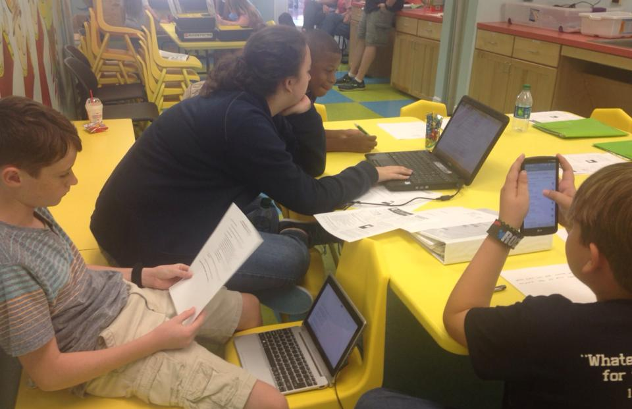
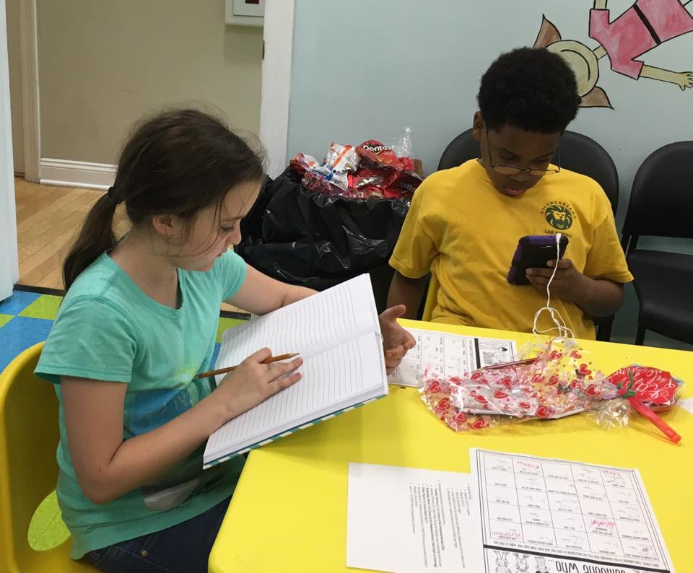
Doing Research Online
Do web searches and get information from reputable sources
Use books, articles and, sometimes, documentaries for research
Shared by: Bayou Builders

Slide 8
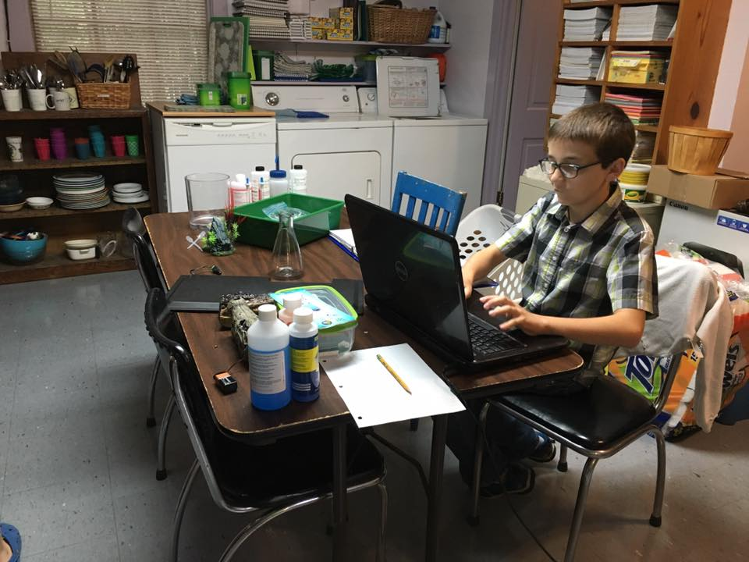

Surveys
In the past, we have also developed surveys using Survey Monkey.
We did this with Animal Allies to learn from teachers how they care for class aquariums.
Shared by: Bayou Builders

Slide 9
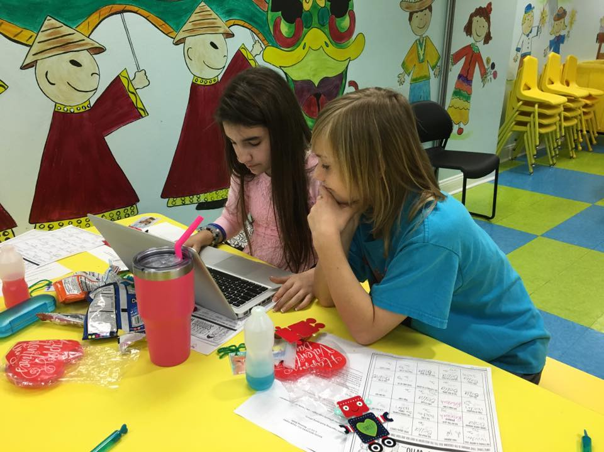
Next Step
Once a solution is identified and developed, you need to do research to ensure that it’s original and practical.
See the next lesson about developing an Innovative Solution by Team Phoenix.
Shared by: Bayou Builders

Slide 10
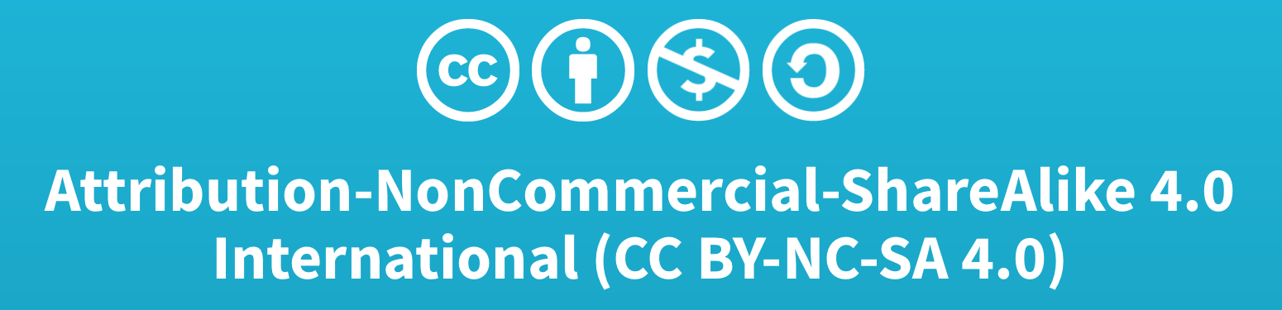
Credits
This lesson was written by Bayou Builders FLL Team #4043 (www.bayoubuilders.org) and Team 3659 NeXT GEN (Facebook:Garrett County FIRST LEGO League Team 3659).
It has been shared with permission with EV3Lessons.com

